Slide 1


Slide 2
Component-Level Design

Slide 3
What is it?
Data Design
Interface Design
Architectural Design
Translate into
Operational Software

Slide 4
What?
What is it?
  Data, architectural, and interface design must be translated into operational software.
  It is represented at a level of abstraction that is close to code.
  The algorithmic detail required to
    Manipulate data structures,
    Effect communication between software components via their interfaces
    Implement the processing algorithms allocated to each component.

Slide 5
When? Who? Why?
When?
Component level design occurs after
  Data design,
  Architectural design and
  Interface design.
  Before code generation
Who does it?
  A software engineer performs component level design
Why is it important?
  You have to be able to determine
    Whether the program will work before you build it.
  Allows you to review the details of the previous designs.
    Whether data structure, architecture and interfaces will work.

Slide 6
What are the steps?
There are two alternatives to represent the design
  Design by using programming languages
  Design by using some intermediate representation
    Graphical Design Notation or
    Tabular Design Notation or
    Text Based Notation

Slide 7
Design must be represented at a level of abstraction that is close to code

Slide 8
Stepwise Refinement
open
walk to door;
reach for knob;
open door;
repeat until door opens
turn knob clockwise;
walk through;
if knob doesn't turn, then
close door.
take key out;
find correct key;
insert in lock;
endif
pull/push door
move out of way;
end repeat

Slide 9
The Component-Level
Design Model
represents the algorithm at a level of detail that can be reviewed for quality options:
  graphical (e.g. flowchart, box diagram)
  pseudocode (e.g., PDL) ... choice of many
  programming language
  decision table
  conduct walkthrough to assess quality

Slide 10
Structured Programming
Foundations formed in the early 1960s
Solidified with the work of Edsgar Dijkstra and colleagues
In the late 1960s proposal of a set of constrained logical constructs from which any program could be formed

Slide 11
Structured Programming
for Procedural Design
uses a limited set of logical constructs:
sequence
conditional
— if-then-else, select-case
loops
— do-while, repeat until
leads to more readable, testable code
important for achieving high quality,
but not enough

Slide 12
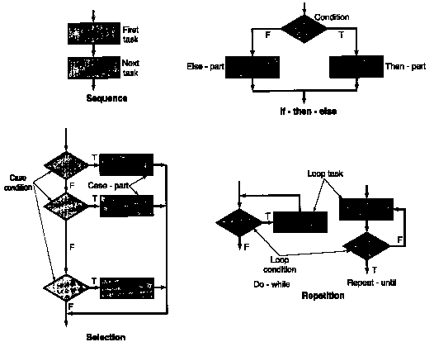
Flowchart Constructs

Slide 13
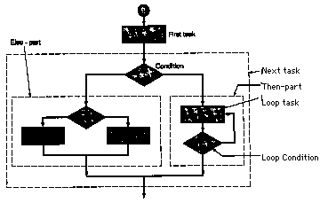
Nested Constructs

Slide 14
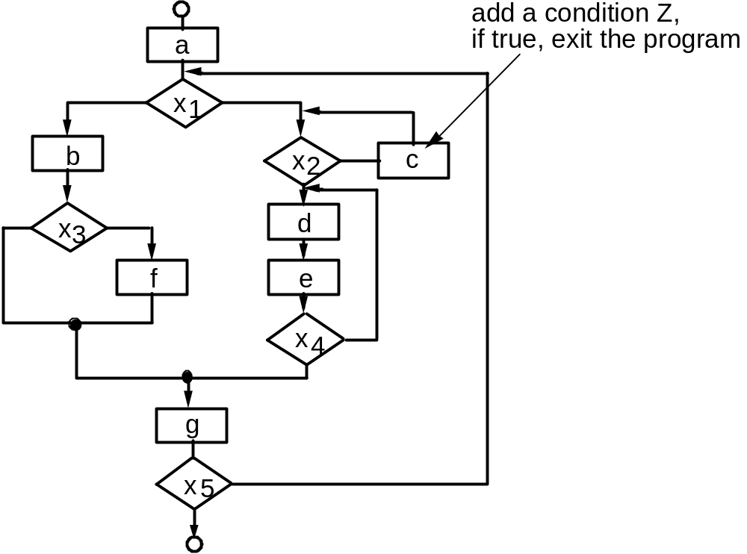
A Structured Procedural Design

Slide 15
Graphical Design Notation (VI)
Another graphical design tool: box diagram
Developed by Nassi and Shneiderman
Extended by Chapin [CHA74]
Also called Nassi-Shneiderman charts, N-S charts, or Chapin charts.

Slide 16
Sequence:
+----------+
Next task
| First |
First task
+----------+
| Second |
+----------+
Next + 1 task
| Third |
+----------+

Slide 17
Condition: If-then-else
+ ------------------- +
| \ test condition / |
| \______ ______/ |
Condition
| True \ / False |
F
T
+---------+--------- +
| Code to | Code to |
| execute | execute |
Else-
part
Then-
part
| when | when |
| TRUE | FALSE |
+--------- + --------- +

Slide 18
Repetition:
Do-while-
part
Repeat-until-
Part
+ -----------------------+
Loop condition
| While loop condition|
Do-while-
part
| +-------------------- +
| | Body of code to |
| | execute multiple|
| | times. |
Loop condition
+-- +-------------------+

Slide 19
Selection
Case condition
Value
Value
…
Case-
part
Case-
part
…

Slide 20
Decision tables
  A decision table is a tabular form that presents a set of conditions and their corresponding actions.
  Provide a notation that translates actions and conditions (described in a processing narrative) into a tabular form

Slide 21
Structure
Decision tables are typically divided into four quadrants
The four quadrants
Conditions
Condition alternatives
Actions
Action entries

Slide 22
Steps
List all actions that can be associated with a specific procedure (or module)
List all conditions (or decisions made) during execution of the procedure
Associate specific sets of conditions with specific actions, eliminating impossible combinations of conditions; alternatively, develop every possible permutation of conditions.
Define rules by indicating what action(s) occurs for a set of conditions

Slide 23
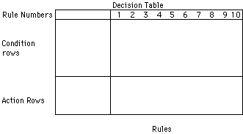

Slide 24
A technical support company writes a decision table to diagnose printer problems based upon symptoms described to them over the phone from their clients.

Slide 25
Printer troubleshooter
Conditions
Printer does not print
Y
Y
Y
Y
N
N
N
N
A red light is flashing
Y
Y
N
N
Y
Y
N
N
Printer is unrecognized
Y
N
Y
N
Y
N
Y
N
Actions
Check the power cable
1
Check the printer-computer cable
1
2
Ensure printer software is installed
2
3
1
1
Check/replace ink
3
1
2
1
Check for paper jam
2
1

Slide 26
... if the customer account is billed using a fixed-rate method, a minimum monthly change is assessed for consumption of less than 100 kwh (kilowatt-hours). Otherwise, computer billing applies a Schedule A rate structure. However, if the account is billed using a variable-rate method, a Schedule A rate structure will apply to consumption below 100 kwh, wilth additional consumption billed according to Schedule B.

Slide 27
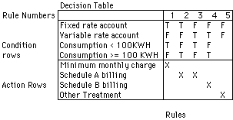

Slide 28
Program Design Language (II)
Design languages characteristics:
A fixed syntax of keywords that provide for all structured constructs, data declaration, and modularity characteristics.
A free syntax of natural language that describes processing features.
Data declaration facilities that should include both simple (scalar, array) and complex (linked list or tree) data structures.
Subprogram definition and calling techniques that support various modes of interface description.

Slide 29
Program Design Language (PDL)
if condition x
then process a;
else process b;
endif
if-then-else
PDL
easy to combine with source code
machine readable, no need for graphics input
graphics can be generated from PDL
enables declaration of data as well as procedure
easier to maintain

Slide 30
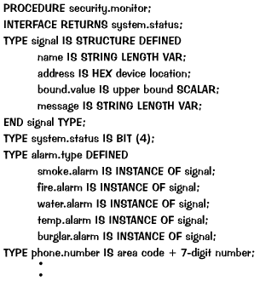
Program Design Language (III)
Example

Slide 31
Program Design Language (IV)
CASE OF control.panel.switch(cps):
  WHEN cps=“test” SELECT
  CALL alarm Procedure WITH “on” for test.time in seconds;
  WHEN cps=“alarm-off” SELECT
  CALL alarm Procedure WITH “off”
  WHEN cps=“new.bound.temp” SELECT
  CALL keypad.input Procedure;
  WHEN cps=“burglar.alarm.off” SELECT
  ...
  DEFAULT none;
ENDCASE
...

Slide 32
Program Design Language (V)
REPEAT UNTIL active.switch is turned off
  reset all signal.values and switches;
  DO FOR alarm.type = smoke, fire, water, temp, burglar;
  READ address [alarm.type] signal.value;
  IF signal.value > bound [alarm.type];
  THEN phone.message = message [alarm.type];
  ...
  ELSE skip
  ENDIF
  ENDFOR
ENDREP

Slide 33
Sentences of structured English (or pseudocode) consist of
Verbs/Actions
  GET/READ, PUT/WRITE, DISPLAY, COMPUTE, ADD, SUBTRACT, MULTIPLY, DIVIDE, DELETE, FIND, MOVE, REPLACE, SET, SORT ...
Nouns/Objects
  elements known in the data dictionary
  local variables in terms of known elements
Adjectives from Domain
  e.g., overdue, on-reserve, ...
Structured Programming Constructs
  IF-THEN-ELSE-ENDIF
  CASE
  DO-WHILE, REPEAT-UNTIL
  make your own: FOREACH X in LIST DO
  use structured programming style (e.g., indentation, meaningful names)

Slide 34
Not Used
  e.g., articles, prepositions, conjunctions, non-content words
Other Guidelines
  Use only standard or obvious control structures
  Avoid programming language punctuation (but use parentheses to clarify order of operations)
  Indicate scope by reasonable means (e.g., indentation, hierarchical numbering)
  Avoid complex conditions (use a decision table instead)

Slide 35
References:
Software Engineering - A practitioner’ s Approach by Roger S. Pressman (6th Ed)
  11.5, 14.1, 14.2, 14.6
Software Engineering - A practitioner’ s Approach by Roger S. Pressman (5th Ed)
  Chapter 16
    16.1-(16.1.1, 16.1.2, 16.1.3, 16.1.4)

